Slide 1
UE20CS971– Project Phase – 1
End Semester Assessment
Project Title : Text Summarization of COVID 19 articles using Question and Answering System using BERT & GPT-2
Project Guide :
By : Venkat K Pillai

Slide 2
Agenda
Problem Statement
Abstract and Scope
Literature Survey
Suggestions from Review – 3
Design Approach
Design Constraints, Assumptions & Dependencies
Proposed Methodology / Approach
Architecture
Design Description
Technologies Used
Project Progress
References

Slide 3
Problem Statement
Since the outbreak of COVID 19 , there has been attempt to study and publish articles related to COVID-19 that are publicly available, to the medical community and wider society. However the challenge of browsing through every article to look for specific content is time consuming and time intensive.

Slide 4
Abstract and Scope
The system aims to tackle the recent challenge of mining the numerous scientific articles being published on COVID-19 , available in CORD-19 Dataset in Kaggle , by using a question answering mechanism and summarize the article with highest probability to the related information.
It combines the use of State of Art Haystack Opensource Framework to identify and extract specific snippets related to user query and summarize the article source using BERT and GPT-2 models.

Slide 5
Literature Survey
R Vaishya and Kricka have noted that the emerging technologies are set to play an important role in worlds response to the COVID-19 pandemic and similar situations.
Broth Andreas et al. proposed a Question- Answering (Q/A) system over Knowledge Bases(KB), which overwhelms impediments which were endured—namely, porting KBs language-agonistic systems.
Rajpurkar, Pranav and team presented the Stanford Question Answering Dataset (SQuAD),
Esteva implemented a retriever-ranker semantic search engine devised to handle complex queries regarding COVID-19
Qiao Jin, Bhuwan Dhingra introduced PubMedQA, a novel biomedical question answering (QA)
Nogueira Rodrigo re-implemented the query based passage re-ranking. Trained on state of the art TRECCAR dataset
In Abacha tried to solve one of the challenges in large-scale information retrieval (IR) is developing fine-grained and domain-specific methods to answer natural language questions

Slide 6
Suggestions from Review - 3
Trim down literature survey to key points
Move all code and materials to GitHub

Slide 7
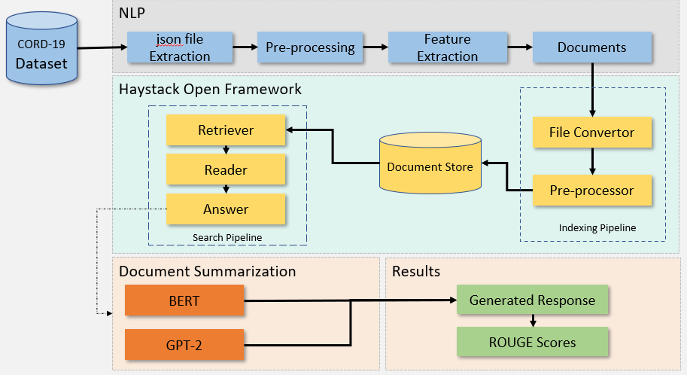
Design Approach
NLP
Json file ingestion from Kaggle CORD 19 dataset
Data clean-up and pre-processing
Convert to DataFrame
Convert DataFrame to documents for Haystack indexing pipeline
Extract top 5 response from retriever-reader pipeline and Identify source document of response
Summarize text using BERT and GPT-2

Slide 8
Design Constraints, Assumptions & Dependencies
Proper and complete question text performs better than short texts. Example - ”What is the most advisable quarantine period for COVID 19”, instead of just ”quarantine period”
Both the readers are tuned for English language only. Reading non English research articles is not effective.
On prem version coding and that of cloud differs, has to be taken care. Streamlit reads from top to bottom every time an stremlit element is chosen, this causes page to render every time.
Due to open source and free cloud version chosen the space and processing capabilities are limited and can cause system to crash.

Slide 9




Design Details
Application was built with Streamlit starting with on local machine and tested with Streamlit cloud version with code in user Github and GL github branch. All py file, csv and text files placed in the same.
For reading and retrieving contents we use Open Haystack Framework, BM25 reader and Inmemorysearch retriever.
The basic code is in python , that identifies the file , summarizes the top scoring file by retriever using BERT and GPT2 with no fine tuning.

Slide 10
Proposed Methodology / Approach
Add as many slides as required to cover the following aspects:
NLP
Extract CORD 19 data from Kaggle
Clean json files and move to csv
Create document from csv ‘text’ column for haystack
Upload csv and text files to Github
Haystack
Read text files using Haystack Reader – Retriever pipeline
Use Streamlit to capture Questions and responses
Identify for scored response and file
Summarization
Summarize files
Evaluate score

Slide 11
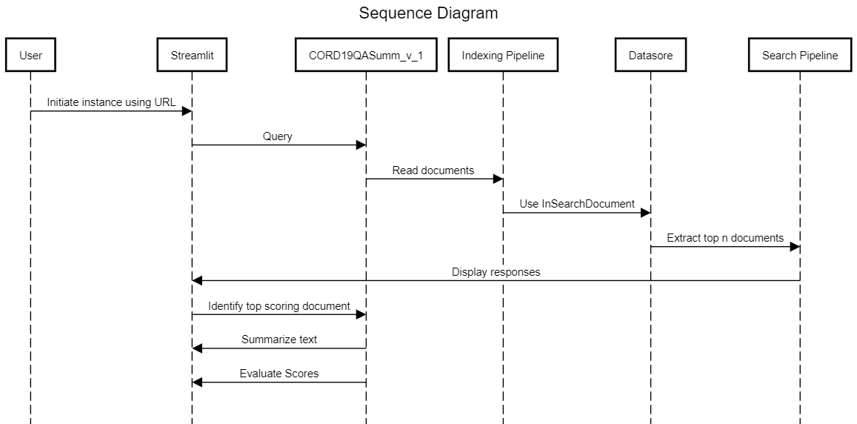
Sequence Flow Diagram

Slide 12
Technologies Used
bert-extractive-summarizer==0.10.1
bert-score==0.3.13
elasticsearch==7.17.9
farm-haystack @ gitdb==4.0.10
GitPython==3.1.31
huggingface-hub==0.12.1
matplotlib==3.7.0
nltk==3.8.1
numpy==1.23.5
openai==0.26.5
pandas==1.5.3
plotly==5.13.1
python-dateutil==2.8.2
python-docx==0.8.11
rank-bm25==0.2.2
requests==2.28.2
rouge==1.0.1
scipy==1.10.0
seaborn==0.12.2
sentence-transformers==2.2.2
sentencepiece==0.1.97
streamlit==1.20.0
tokenizers==0.13.2
transformers==4.25.1

Slide 13
Project Progress
Code Deployment on Github – (Great Learning ) and Streamlit Cloud completed.
Next steps to add novelty features

Slide 14
References
[1] A. B. Abacha, S. A. Hasan, V. V. Datla, J. Liu, D. Demner-Fushman, and H. M ̈uller. Vqa-med: Overview of the medical visual question answering task at imageclef 2019. CLEF (working notes), 2(6), 2019.
[2] T. Acter, N. Uddin, J. Das, A. Akhter, T. R. Choudhury, and S. Kim. Evolution of severe acute respiratory syndrome coronavirus 2 (sars-cov-2) as coronavirus disease 2019 (covid-19) pandemic:A global health emergency. Science of the Total Environment, 730:138996, 2020.
[3] N. A. Akbar, I. Darmayanti, S. M. Fati, and A. Muneer. Deep learning of a pre-trained language model’s joke classifier using gpt-2. Journal of Hunan University Natural Sciences, 48(8), 2021.
[4] A. Ben Abacha and D. Demner-Fushman. A question-entailment approach to question answering.BMC bioinformatics, 20(1):1–23, 2019.
[5] P. B. Brandtzaeg and A. Følstad. Why people use chatbots. In Internet Science: 4th International Conference, INSCI 2017, Thessaloniki, Greece, November 22-24, 2017, Proceedings 4, pages 377–392. Springer, 2017.
[6] K. M. Colby, S. Weber, and F. D. Hilf. Artificial paranoia. Artificial intelligence, 2(1):1–25, 1971.
[7] D. Diefenbach, A. Both, K. Singh, and P. Maret. Towards a question answering system over the semantic web. Semantic Web, 11(3):421–439, 2020.
[8] A. Esteva, A. Kale, R. Paulus, K. Hashimoto, W. Yin, D. Radev, and R. Socher. Co-search: Covid- 19 information retrieval with semantic search, question answering, and abstractive summarization. arXiv preprint arXiv:2006.09595, 2020.
[9] S. Hofst ̈atter, M. Zlabinger, M. Sertkan, M. Schr ̈oder, and A. Hanbury. Fine-grained relevance annotations for multi-task document ranking and question answering. In Proceedings of the 29th ACM International Conference on Information & Knowledge Management, pages 3031–3038, 2020.
[10] Q. Jin, B. Dhingra, Z. Liu, W. W. Cohen, and X. Lu. Pubmedqa: A dataset for biomedical research question answering. arXiv preprint arXiv:1909.06146, 2019.

Slide 15
References
[11] R. Khan, A. Das, R. Khan, and A. Das. Introduction to chatbots. Build better chatbots: A complete guide to getting started with chatbots, pages 1–11, 2018.
[12] L. C. Klopfenstein, S. Delpriori, S. Malatini, and A. Bogliolo. The rise of bots: A survey of conversational interfaces, patterns, and paradigms. In Proceedings of the 2017 conference on designing interactive systems, pages 555–565, 2017.
[13] L. J. Kricka, S. Polevikov, J. Y. Park, P. Fortina, S. Bernardini, D. Satchkov, V. Kolesov, and M. Grishkov. Artificial intelligence-powered search tools and resources in the fight against covid- 19. Ejifcc, 31(2):106, 2020.
[14] J. Lin, D. Quan, V. Sinha, K. Bakshi, D. Huynh, B. Katz, and D. R. Karger. What makes a good answer? the role of context in question answering. In INTERACT, 2003.
[15] M. d. G. B. Marietto, R. V. de Aguiar, G. d. O. Barbosa, W. T. Botelho, E. Pimentel, R. d. S. Fran ̧ca, and V. L. da Silva. Artificial intelligence markup language: a brief tutorial. arXiv preprint arXiv:1307.3091, 2013.
[16] G. Moln ́ar and Z. Sz ̈uts. The role of chatbots in formal education. In 2018 IEEE 16th International Symposium on Intelligent Systems and Informatics (SISY), pages 000197–000202. IEEE, 2018.
[17] R. Nogueira and K. Cho. Passage re-ranking with bert. corr abs/1901.04085 (2019). arXiv preprint arXiv:1901.04085, 2019.
[18] P. Rajpurkar, J. Zhang, K. Lopyrev, and P. Liang. Squad: 100,000+ questions for machine comprehension of text. arXiv preprint arXiv:1606.05250, 2016.
[19] I. Shen, L. Zhang, J. Lian, C.-H. Wu, M. G. Fierro, A. Argyriou, and T. Wu. In search for a cure: recommendation with knowledge graph on cord-19. In Proceedings of the 26th ACM SIGKDD International Conference on Knowledge Discovery & Data Mining, pages 3519–3520, 2020.
[20] D. Su, Y. Xu, T. Yu, F. B. Siddique, E. J. Barezi, and P. Fung. Caire-covid: A question answer- ing and query-focused multi-document summarization system for covid-19 scholarly information management. arXiv preprint arXiv:2005.03975, 2020.

Slide 16
References
[21] R. Tang, R. Nogueira, E. Zhang, N. Gupta, P. Cam, K. Cho, and J. Lin. Rapidly bootstrapping a question answering dataset for covid-19. arXiv preprint arXiv:2004.11339, 2020.
[22] A. M. Turing. Computing machinery and intelligence. Springer, 2009. [23] R. Vaishya, M. Javaid, I. H. Khan, and A. Haleem. Artificial intelligence (ai) applications for covid-19 pandemic. Diabetes & Metabolic Syndrome: Clinical Research & Reviews, 14(4):337–339, 2020.
[24] J. Weizenbaum. Eliza—a computer program for the study of natural language communication between man and machine. Communications of the ACM, 9(1):36–45, 1966.
[25] C. Wise, V. N. Ioannidis, M. R. Calvo, X. Song, G. Price, N. Kulkarni, R. Brand, P. Bhatia, and G. Karypis. Covid-19 knowledge graph: accelerating information retrieval and discovery for scientific literature. arXiv preprint arXiv:2007.12731, 2020.
[26] W. Yu, L. Wu, Y. Deng, R. Mahindru, Q. Zeng, S. Guven, and M. Jiang. A technical question answering system with transfer learning. In Proceedings of the 2020 Conference on Empirical Methods in Natural Language Processing: System Demonstrations, pages 92–99, 2020.

Slide 17
Thank You

Slide 18
Proposed Methodology / Approach
https://greatlearningdegreeprogram-may21-p-cloudcord19qasumm-v-1-z4ke65.streamlit.app/

Slide 19
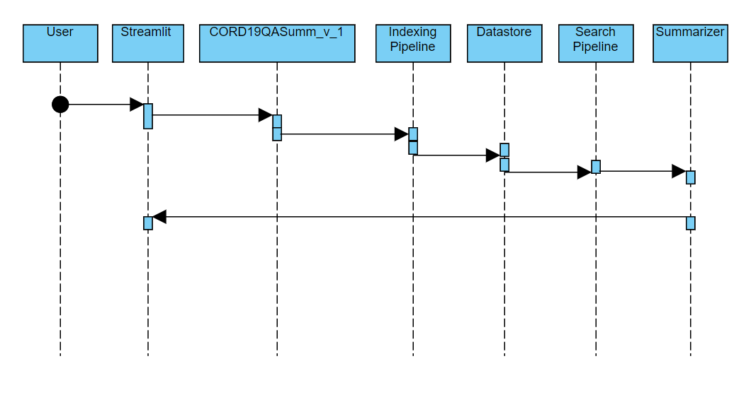
Sequence Flow Diagram
URL
Query
Read Docs
Retrieve top 5 Docs
Display Results

